Slide 1

Poly U Robotic Team Electronic tutorial 2022-23
Introduction
By Samson Chau

Slide 2

Topic
Electronic Basics
PCB design and circuit basics
Programming and Firmware
Tools and Equipment

Slide 3

Electronic Basics and MCU programming
https://github.com/SamsonChau/Robocon_Training_2021-2022_backup/tree/main/Electronics
https://github.com/SamsonChau/Robocon_Training_2021-2022_backup/tree/main/MCU_Programing

Slide 4
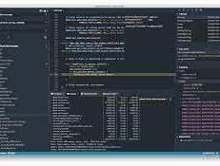



Programming Tools and IDE
Arduino IDE
Mbed Studio/ CLI
VScode
TeraTerm / minicom

Slide 5
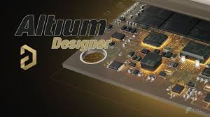

PCB Drawing EDA tools
Altium
Kicad 6

Slide 6
How to develop a project with others
https://www.atlassian.com/git/tutorials/comparing-workflows/gitflow-workflow

Slide 7

GitHub Usage
There have an official Site of PolyU-Robotics Team
https://github.com/PolyU-Robocon
Also this is my personal github
https://github.com/SamsonChau

Slide 8
What we wanna do in this Sem?
Set some goal from now!

Slide 9
More Useful Documentation
HKU Robotics Club:
https://docs.m2stud.io/
Where u can find extra info about the ROS and linux information

